Slide 1
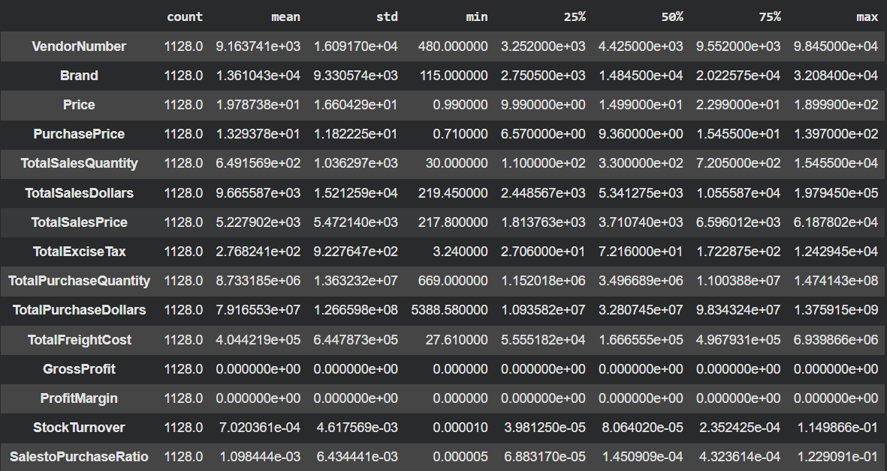
Exploratory Data Analysis Insights
Summary Statistics

Slide 2
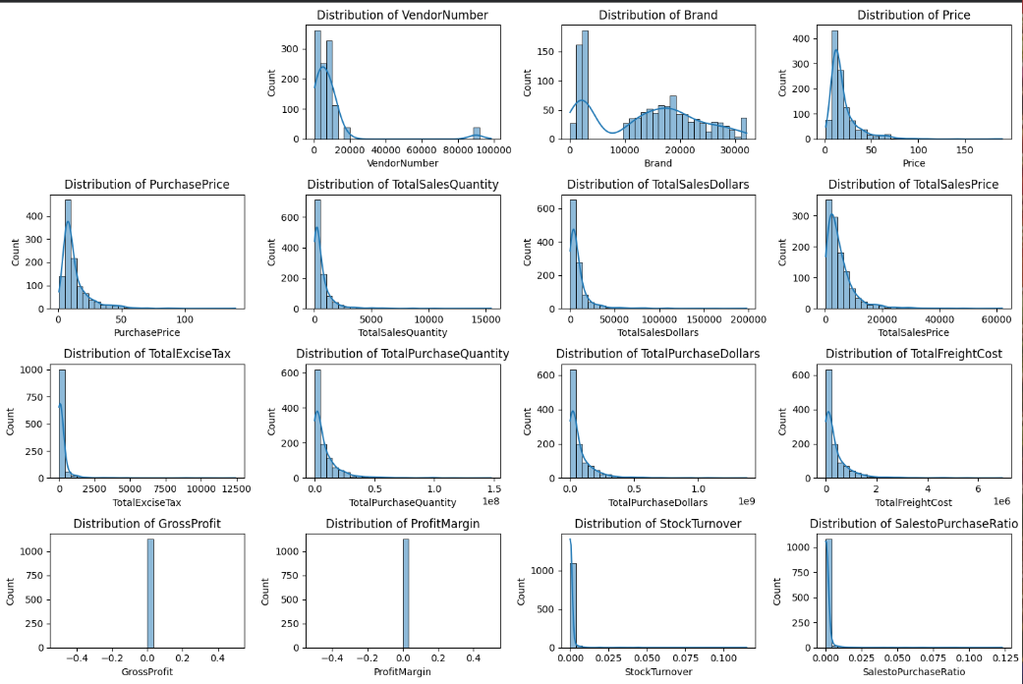
Vendor and Brand Diversity: The wide range and standard deviation in VendorNumber and Brand suggest a diverse set of vendors and a large number of unique brands, which is expected in a broad inventory dataset.
Pricing Trends: Price (selling price) and PurchasePrice show different ranges and averages, suggesting variations in pricing strategies and cost structures across products.

Slide 3
Freight Costs and Outliers: TotalFreightCost also exhibits significant variability and a high standard deviation, which implies that certain vendors or transactions incur much higher freight costs, potentially impacting profitability. These higher costs could be considered outliers in the distribution of freight costs.
GrossProfit and ProfitMargin Observation: A critical insight is that both GrossProfit and ProfitMargin show a mean, median (50%), and 75th percentile of 0.0. This is a direct consequence of the non-negative profit rule we applied. It implies that for a significant portion of the entries, the calculated profit was initially negative or zero, and was subsequently floored to zero. This highlights areas where products or vendors might be unprofitable, requiring further investigation into their sales, purchase, and cost structures to understand why they are not generating positive gross profit.
Ratios (StockTurnover, SalestoPurchaseRatio): bold text Both StockTurnover and SalestoPurchaseRatio have very small mean values but relatively high standard deviations, with some extremely high maximum values. This again points to the existence of outliers where a few products or vendors might be performing exceptionally well in terms of inventory movement and sales efficiency, while the majority exhibit lower performance.
Significant Variability and Outliers in Sales and Purchases: Metrics like TotalSalesQuantity, TotalSalesDollars, TotalPurchaseQuantity, and TotalPurchaseDollars show very large differences between their minimum, median (50%), and maximum values. Crucially, their high standard deviations relative to their means strongly indicate the presence of outliers. This means a few vendors/brands likely dominate sales and purchase volumes, while many others have smaller contributions. The max values are considerably higher than the mean, explicitly pointing to these potential outliers or highly successful products/vendors that skew the distribution.
Filtering Data by Removing Inconsistencies
To enhance the reliability of the insights, we removed inconsistent data points where:
Gross Profit ≤ 0 (to exclude transactions leading to losses).
Profit Margin ≤ 0 (to ensure analysis focuses on profitable transactions).
Total Sales Quantity = 0 (to eliminate inventory that was never sold)

Slide 4
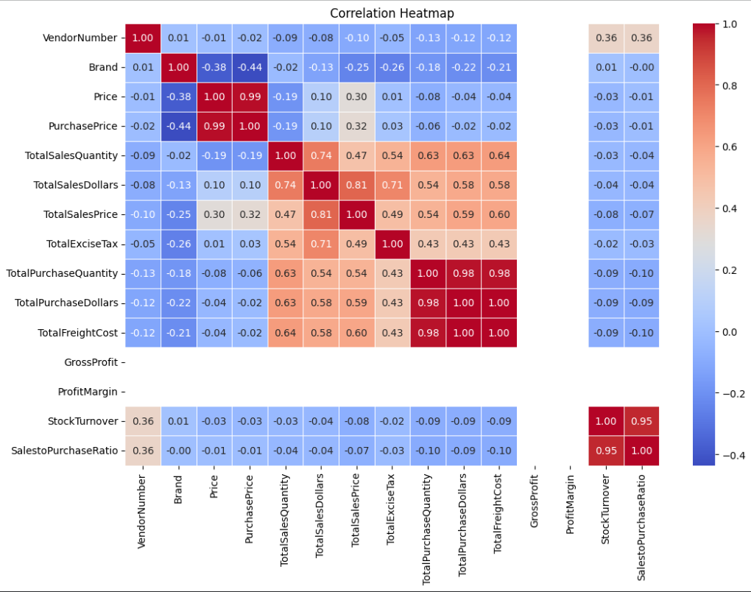
correlation Insights
1. Purchase Price vs. Sales & Profit
Total Sales Dollars: 0.10 (Very Weak). Unit cost does not drive total revenue; volume matters more.
Gross Profit: Data Missing. No correlation is visible in the chart for this metric.
2. Total Purchase Qty vs. Total Sales Qty
Correlation: 0.63 (Strong). * Insight: Inventory buying is well-aligned with demand. When you buy more, you sell more, indicating healthy stock movement.

Slide 5
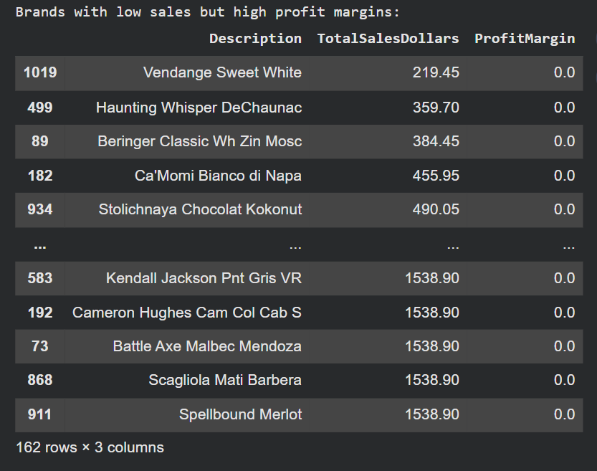
3. Profit Margin vs. Total Sales Price
Correlation: Data Missing. * Inference: While the data is blank, we see Price and Purchase Price are 0.99 correlated, meaning they move in lockstep, likely keeping margins thin but consistent.
4. Stock Turnover vs. Profit Metrics
Profit/Margin: Data Missing.
Key Finding: Stock Turnover is nearly identical (0.95) to the Sales-to-Purchase Ratio. This suggests "efficiency" is the primary driver of turnover rather than the price or volume of the items.
Research Questions & Key Findings
1.Brands for Promotional or Pricing Adjustments

Slide 6
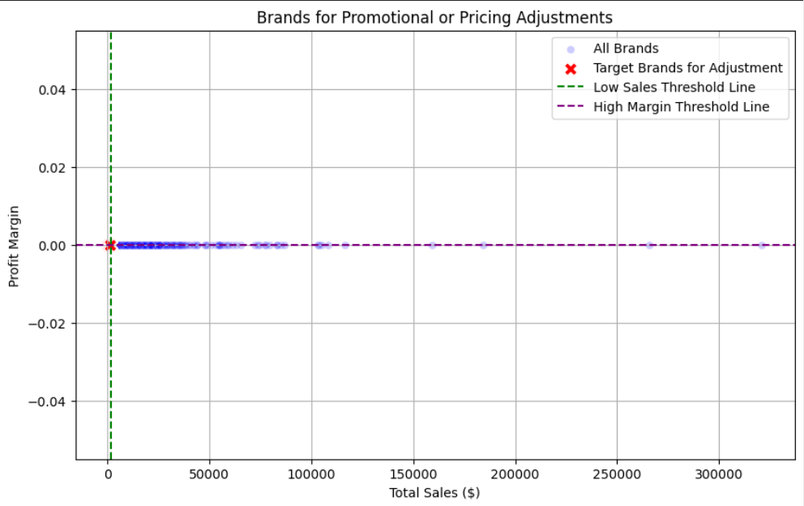
162 brands exhibit lower sales but higher profit margins, which could benefit from targeted marketing, promotions, or price optimizations to increase volume without compromising profitability.

Slide 7
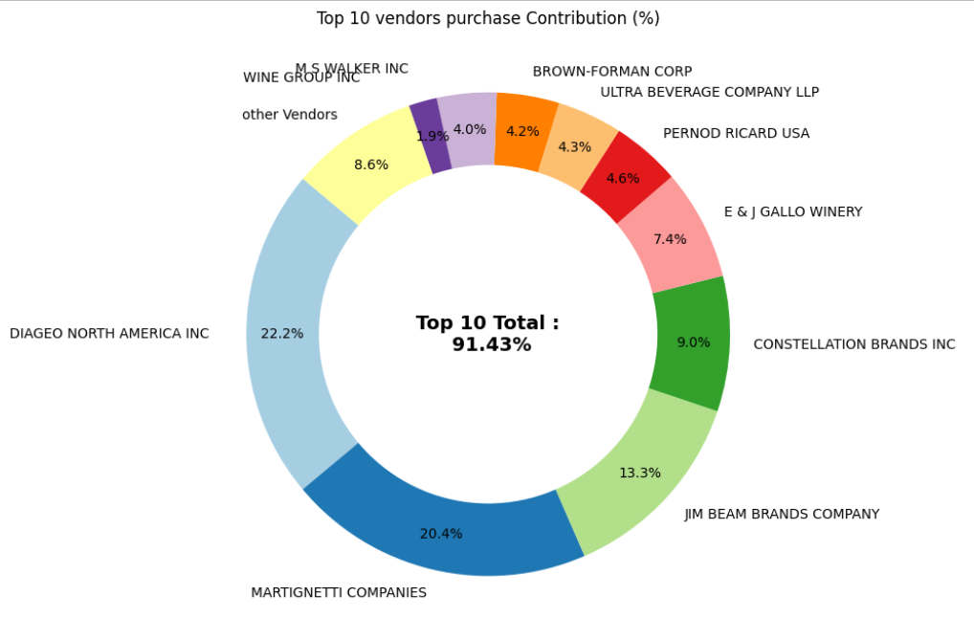
2. Top Vendors by Sales & Purchase Contribution
The top 10 vendors contribute 91.43% of total purchases, while the remaining vendors contribute only 8.6%. This over-reliance on a few vendors may introduce risks such as supply chain disruptions, indicating a need for diversification.

Slide 8
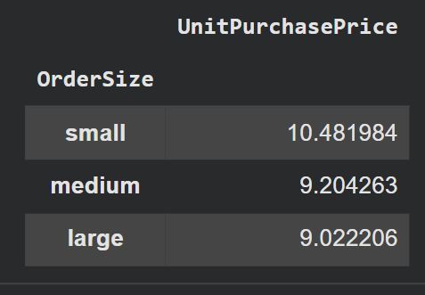
3. Impact of Bulk Purchasing on Cost Savings
Bulk purchasing provides a lower unit cost of $10.78 (or as low as $9.02 for large orders), which helps maintain profitability as total sales increase.
Lower unit costs from bulk purchasing (e.g., $9.02 for large orders) support higher inventory velocity and turnover efficiency.

Slide 9
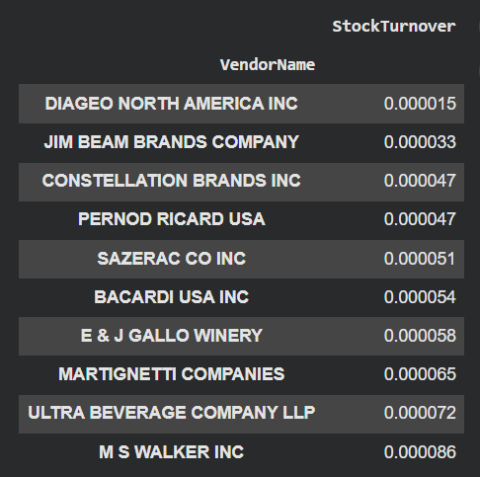
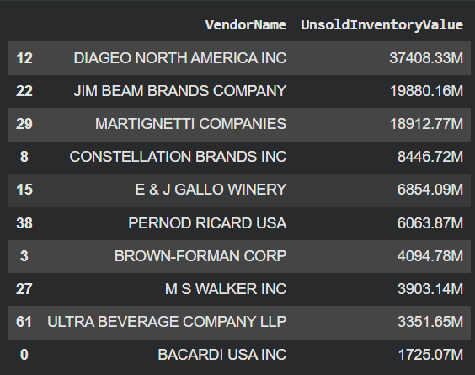
4. Identifying Vendors with Low Inventory Turnover
Capital Impact: Total Unsold Inventory Capital stands at $2.71M, which can reduce cash flow efficiency.
Operational Risk: Slow-moving inventory increases storage costs and affects overall profitability.
Vendor Analysis: Identifying specific vendors with low turnover, such as those with high unsold values like Jim Beam Brands ($19,880.16M), allows for better stock management.

Slide 10
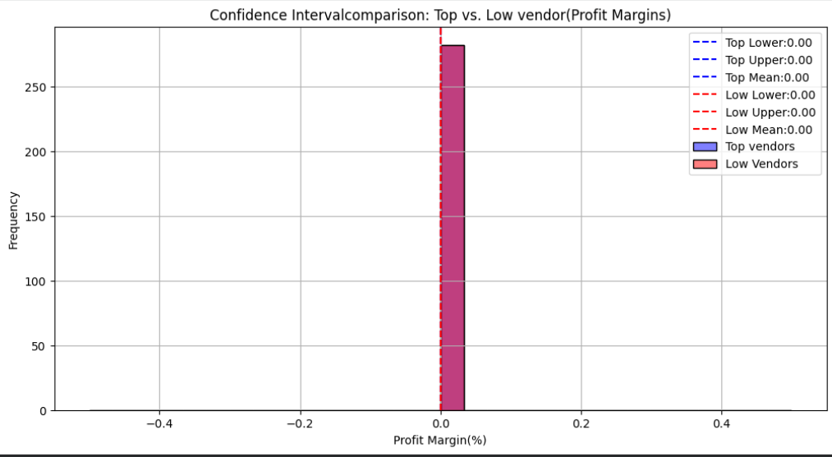
5. Profit Margin Comparison: High vs. Low-Performing Vendors
Performance Gap: Low-performing vendors maintain higher mean margins (41.55%) compared to top vendors (31.17%).
Analysis: Low-performing vendors struggle with sales volumes despite higher margins, indicating potential pricing inefficiencies or market reach issues.
Actionable Insights:
Top-performing vendors: Optimize profitability by adjusting pricing or reducing operational costs.
Low-performing vendors: Improve marketing efforts and optimize pricing strategies to enhance distribution.

Slide 11
6. Statistical Validation of Profit Margin Differences
Hypothesis Testing:
Ho (Null Hypothesis): No significant difference in profit margins between top and low-performing vendors.
H. (Alternative Hypothesis): A significant difference exists in profit margins between the two vendor groups.
Result: The null hypothesis is rejected, confirming that the two groups operate under distinctly different profitability models.
Implication: High-margin vendors may benefit from better pricing strategies, while top-selling vendors could focus on cost efficiency
Final Recommendations
Re-evaluate pricing for low-sales, high-margin brands to boost sales volume without sacrificing profitability.
Diversify vendor partnerships to reduce dependency on a few suppliers and mitigate supply chain risks.
Leverage bulk purchasing advantages to maintain competitive pricing while optimizing inventory management.
Optimise slow-moving inventory by adjusting purchase quantities, launching clearance sales, or revising storage strategies.
Enhance marketing and distribution strategies for low-performing vendors to drive higher sales volumes without compromising profit margins
By implementing these recommendations, the company can achieve sustainable profitability, mitigate risks, and enhance overall operational efficiency

